Slide 1


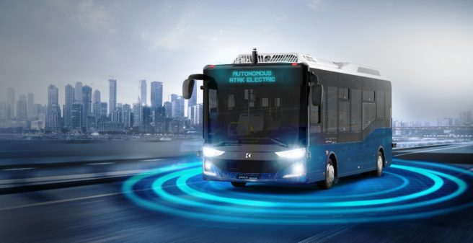
Introduction to OR

Slide 2

Related Repo

Slide 3
Proje
3-4-5 kişilik gruplar, grup bulamayana ben proje vereceğim.
Proje konusunda ele alınacak problem, bu sunumda verilen 9 konudan biri olmalı, verilen 9 algoritmadan iki tanesi aynı probleme uygulanmalı (Son tarih: 18 Mart Pztesi)
Vize: %40, Final: %60 + Proje Sunumu (0-20P, Bütünleme’dede geçerli)

Slide 4
Proje
Proje sunum ve kodlar son gönderim tarihi: 5 Nisan Cuma
Proje Sunumu (20 dakika+ 10 dakika soru)
Sunumlar Başlama Tarihi: 12 Nisan Cuma (Github’da sunum sırası yayınlanacak)
yigitkuyu@uludag.edu.tr (Okul nosu ve isim/soyisim ile beraber grup ve proje konusu, mail başlığı: OR Proje)
Programlama dili: C++, Python

Slide 5
Sunum Formatı
Giriş: Genel bir literatür hakkında bilgi, bu konuda seçilen algoritma ve problem türü ile ilgili nasıl çalışmalar yapılmış

Slide 6
Sunum Formatı
Method: Seçilen algoritmanın adım adım çalışma mantığı, akış diyagramı ve sözde kodu.

Slide 7
Sunum Formatı
Problem: Ele alınan problemin mantığı nedir, matematiksel denklemleri, problemin sınırları ve karar değişkenleri nelerdir.

Slide 8
Sunum Formatı
Uygulama: Geliştirdiğin metodu nasıl uyguladın sunumda anlatılacak, adım adım program çalıştırılacak.
Not: Tüm sunum sadece yazıdan oluşmayıp, görsellerle desteklenecektir. Benzer sunumlar “-10” puan ile ödüllendirilecektir.

Slide 9
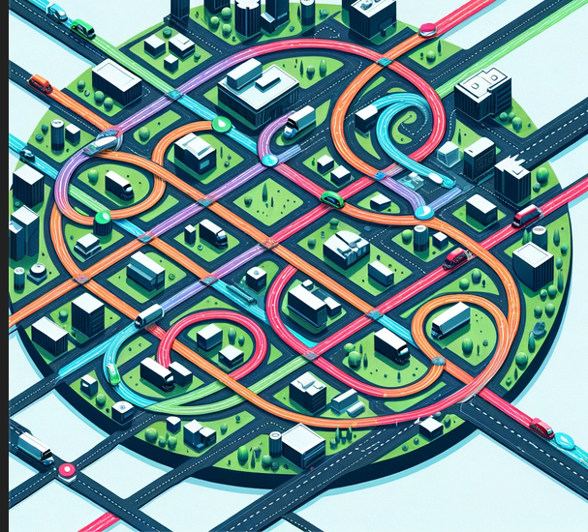
Specific type of OR Problems
•Vehicle Routing Problem (VRP)
The Vehicle Routing Problem involves determining the optimal routes for a fleet of vehicles to deliver goods or services to a set of customers, starting and ending at a depot, while minimizing total distance traveled, cost, or time.

Slide 10
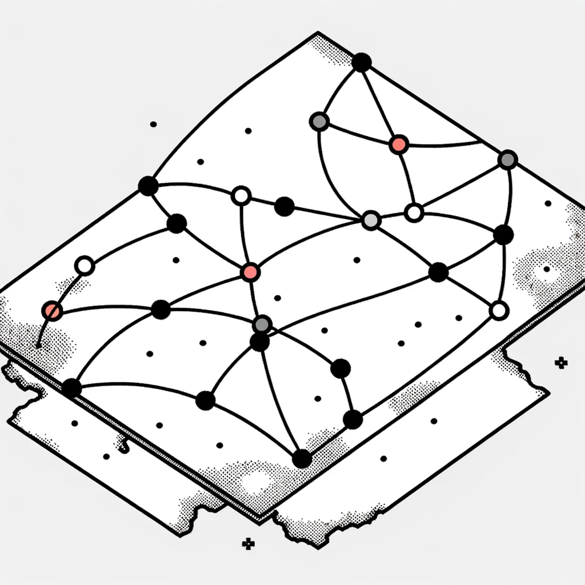
Specific type of OR Problems
Traveling Salesman Problem (TSP)
The Traveling Salesman Problem asks for the shortest possible route that visits a set of cities exactly once and returns to the origin city.

Slide 11
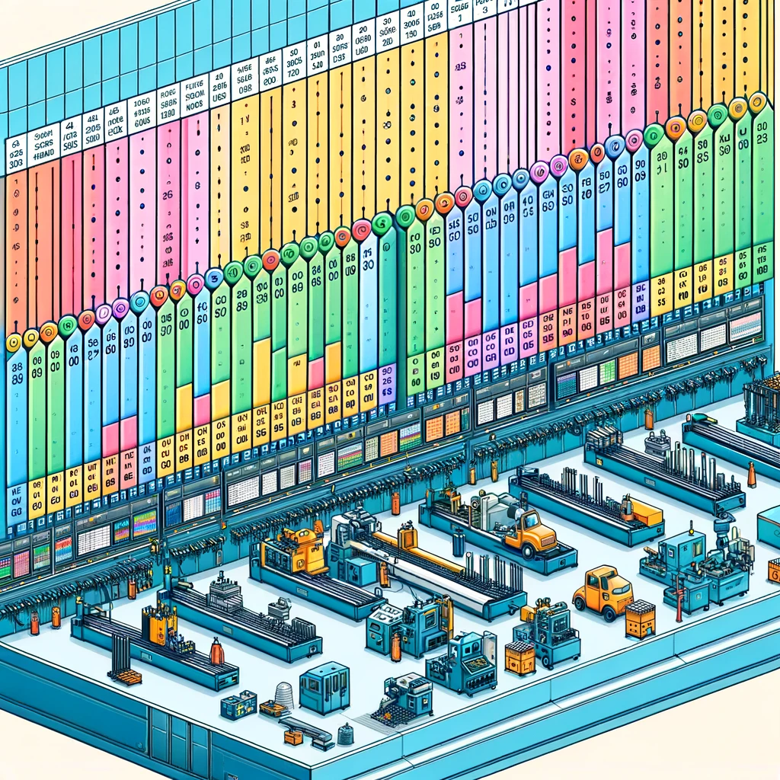
Specific type of OR Problems
Job Shop Scheduling (JSS)
Job Shop Scheduling involves scheduling jobs on machines or production facilities, where each job consists of a sequence of tasks that need to be performed on specific machines in a particular order. The objective often is to minimize the total time needed to complete all jobs (makespan), optimize machine utilization, or minimize job tardiness.

Slide 12

Specific type of OR Problems
Knapsack Problem
The Knapsack Problem involves selecting items from a set, each with a weight and a value, to include in a knapsack so that the total weight is less than or equal to a given limit and the total value is maximized. It has applications in resource allocation, budget management, and in constructing portfolios in finance.

Slide 13

Specific type of OR Problems
Facility Location Problem
This problem focuses on finding the best locations for facilities (warehouses, factories, fire stations, etc.) to minimize transportation costs, serve customer demand efficiently, or maximize coverage. It's fundamental in supply chain design, urban planning, and logistics.

Slide 14

Specific type of OR Problems
Network Design
Network Design problems involve configuring a network (e.g., telecommunications, transportation, or logistics networks) to meet certain criteria, such as minimizing cost, maximizing capacity, or optimizing flow. This can include determining the locations of nodes, the paths between them, and the capacity of each link.

Slide 15

Specific type of OR Problems
Inventory Management Problems
These problems deal with determining the optimal order quantity and reorder points for inventory to minimize holding, ordering, and shortage costs. This is critical for efficient supply chain management, reducing operational costs, and ensuring product availability.

Slide 16
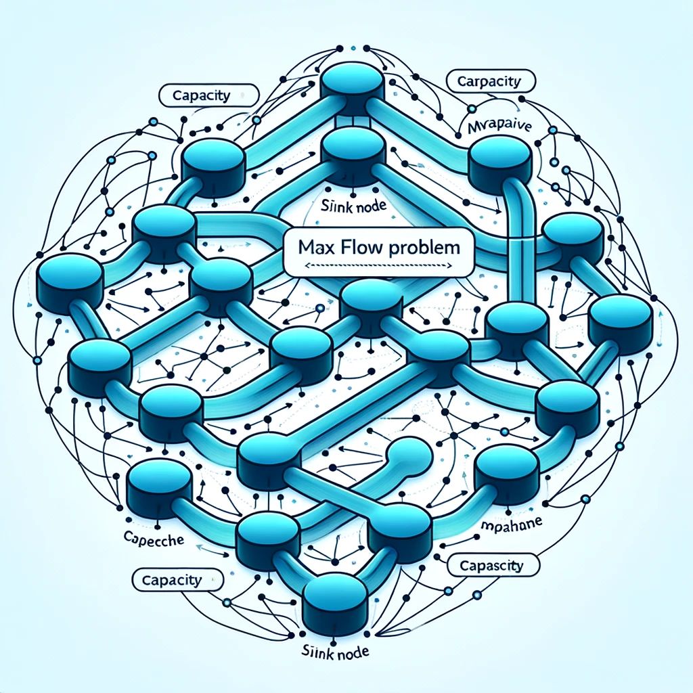
Specific type of OR Problems
Max Flow Problem
The Maximum Flow problem aims to find the maximum amount of flow that can be sent from a source to a sink in a flow network, such that the flow through any edge does not exceed its capacity. It's applicable in traffic management, network design, and resource allocation.

Slide 17
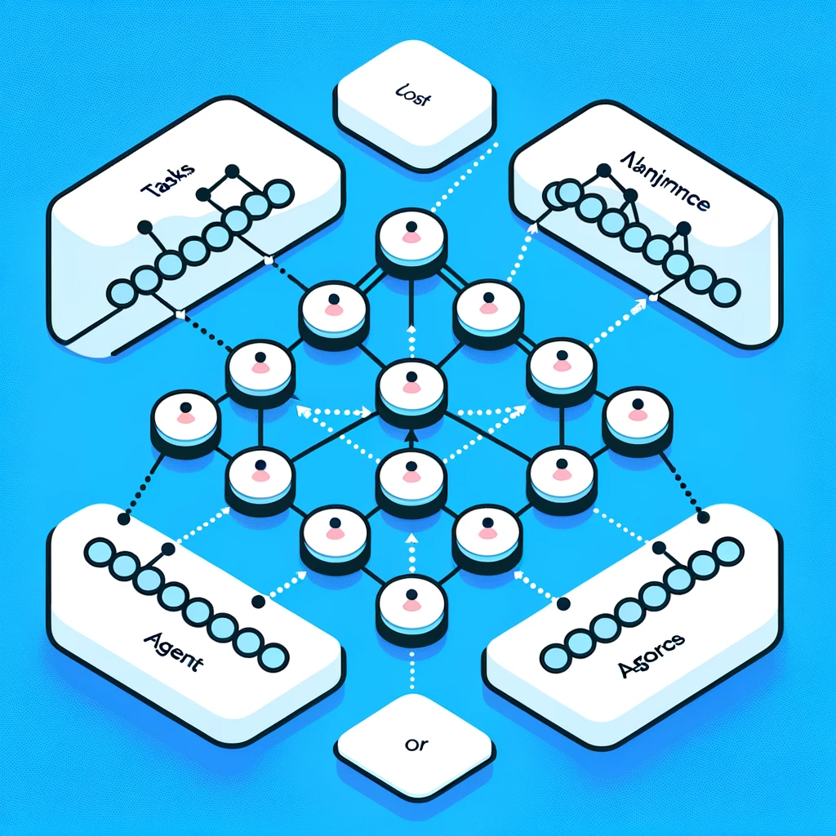
Specific type of OR Problems
Assignment Problem
The Assignment Problem involves assigning a set of tasks to a set of agents in the best way possible, such as minimizing total costs or maximizing efficiency. Applications include task assignment in project management, assigning employees to jobs, and allocating resources in production processes.

Slide 18
Specific type of OR Problems
Assignment Problem
The Assignment Problem involves assigning a set of tasks to a set of agents in the best way possible, such as minimizing total costs or maximizing efficiency. Applications include task assignment in project management, assigning employees to jobs, and allocating resources in production processes.

Slide 19
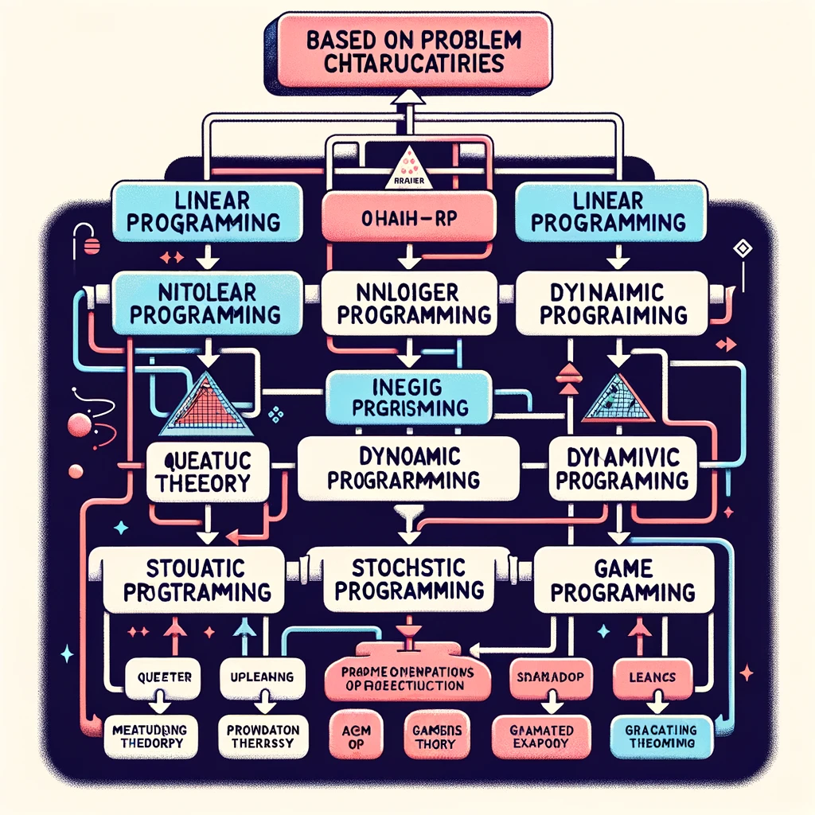
OR Diagram

Slide 20
Algorithms
1) Genetic Algorithm
2) Particle Swarm Optimization
3) Differential Evolution Algorithm
4) Ant Colony OptimizationAlgorithm
5) Artificial Bee Colony Algorithm
6) Simulated Annealing
7) Grey Wolf Optimizer
8) Tabu Search Algorithm
9) Cuckoo Search Algorithm

